Slide 1
Professional JavaScript for
Web Development
Chapter-13 : Events
PRESENTED BY:
DAW SAW THANDAR SHWE
LECTURER
ITSM DEPARTMENT
UNIVERSITY OF COMPUTER STUDIES (SITTWAY)
Information Technology Supporting and Maintenance

Slide 2
Outline
Event
Event Flow
Event Handler
Event Object
Event Type
Information Technology Supporting and Maintenance

Slide 3
What is Event?
Events are actions performed either by the user or by the browser itself.
Eg: click, load, mouseover, mouseout, focus, blur etc…..
Function that is called in response to an event is called event handler or event listener.
Event handlers have names beginning with “on”, so an event handler for the click event is called onclick and an event handler for the load event is called onload and event handler for mouseover event is called onmouseover.
Information Technology Supporting and Maintenance

Slide 4
What is Event?
Events are actions performed either by the user or by the browser itself.
Eg: click, load, mouseover, mouseout, focus, blur etc…..
Function that is called in response to an event is called event handler or event listener.
Event handlers have names beginning with “on”, so an event handler for the click event is called onclick and an event handler for the load event is called onload and event handler for mouseover event is called onmouseover.
Information Technology Supporting and Maintenance

Slide 5
Event Flow
Event flow describes the order in which events are received on the page.
<!DOCTYPE html>
<html>
<head>
<title>Event Bubbling Example</title>
</head>
<body>
<div id= “myDiv”>Click Me</div>
</body>
</html>
Information Technology Supporting and Maintenance

Slide 6
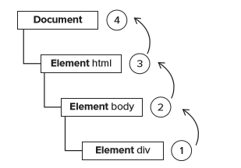
Event Flow
1. Event Bubbling (Internet Explorer)
the click event goes up the DOM tree, firing on each node along its way until it reaches the document object
<div>
<body>
<html>
document
Information Technology Supporting and Maintenance

Slide 7
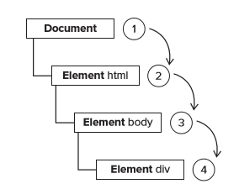
Event Flow
2. Event Capturing (Netscape Communicator team)
With event capturing, the click event is first received by the document and then continues down the DOM tree to the actual target of the event
Document
<html>
<body>
<div>
Information Technology Supporting and Maintenance

Slide 8
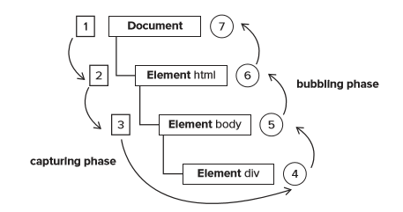
DOM Event Flow
The event flow specified by the DOM Level 2 Events has three phases: has three phase
Event Capturing Phase
At the target
Event Bubbling Phase
Information Technology Supporting and Maintenance

Slide 9
Event Handler
HTML Event Handler
DOM Level 0 Event Handler
DOM Level 2 Event Handler
Internet Explorer Event Handler
Cross-Browser Event Handler
Information Technology Supporting and Maintenance

Slide 10
1.HTML Event Handler
<body>
<input type=“button” value=“Click Me” onclick=“alert(event.type)”>
<input type=“button” value=“Click Me” onclick=“alert(this.value)”>
<input type=“button” value=“Click Me” onclick=“alert(‘Hello World’)”>
</body>
<html><head><title>HTML Event Handler Example</title></head><body>
<script type=“text/javascript>
function show(){
alert(“Hello World!”);}
</script>
<input type=“button” ” value=“Click Me” onclick=“show()”>
</body></html>
Click Me
Hello World!
Information Technology Supporting and Maintenance

Slide 11
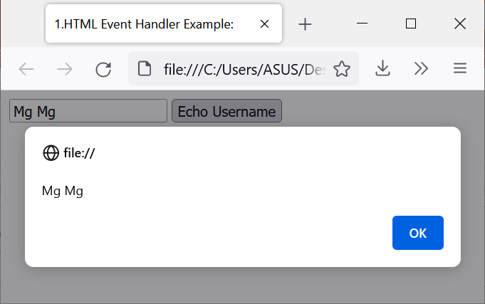
1. HTML Event Handler Example:
<form method=“post”>
<input type=“text” name=“username” value=“ ”>
<input type=“button” value=“Echo Username” onclick=“alert(username.value)”>
</form>
Information Technology Supporting and Maintenance

Slide 12
2. DOM Level 0 Event Handler
<!DOCTYPE html>
<html>
<head><title> DOM Level 0 Event Handler Example 1</title></head>
<body>
<input type="button" value="Click Me" id="myBtn">
<script type="text/javascript">
var btn=document.getElementById("myBtn");
btn.onclick=function()
{ alert("Hello!"); };
</script></body></html>
Information Technology Supporting and Maintenance

Slide 13
2. DOM Level 0 Event Handler
Remove
<!DOCTYPE html>
<html>
<head><title> DOM Level 0 Event Handler Example 2</title></head>
<body>
<input type="button" value="Click Me" id="removeBtn">
<script type="text/javascript">
var removeBtn=document.getElementById("removeBtn");
removeBtn.onclick=null;
</script></body></html>
Information Technology Supporting and Maintenance

Slide 14
3. DOM Level 2 Event Handler
Multiple event handler can be added
addEventListener( )
-addEventListener(Event Type, Function, Boolean)//true-Capture phase
// false-Bubble phase
removeEventListener( )
-removeEventListener(Event Type, Function, Boolean)
Information Technology Supporting and Maintenance

Slide 15
3. DOM Level 2 Event Handler
<!DOCTYPE html>
<html>
<head><title> DOM Level 2 Event Handler Example 1</title></head>
<body>
<input type="button" value="Click Me" id="myBtn">
<script type="text/javascript">
var btn=document.getElementById("myBtn");
btn.addEventListener(“click",function(){alert("welcome");},false);
btn.removeEventListener(“click",function(){alert("welcome");},false);
</script></body></html>
Information Technology Supporting and Maintenance

Slide 16
3. DOM Level 2 Event Handler
<!DOCTYPE html><html>
<head><title> DOM Level 2 Event Handler Example 2</title></head>
<body>
<input type="button" value="Click Me" id="myBtn">
<script type="text/javascript">
var btn=document.getElementById("myBtn");
var h=function(){
alert("welcome");};
btn.addEventListener(“click",h,false);
btn.removeEventListener(“click",h,false);
</script></body></html>
Information Technology Supporting and Maintenance

Slide 17
3. DOM Level 2 Event Handler
<!DOCTYPE html><html>
<head><title> DOM Level 2 Event Handler Example 3</title>
</head>
<body>
<input type="button" value="Click Me" id="myBtn">
<input type="button" value="remove Event Handler" id="myRemoveBtn">
<script type="text/javascript">
var btn=document.getElementById("myBtn");
var h=function(){alert("welcome");};
btn.addEventListener("Click",h,false);
var remove=document.getElementById("myRemoveBtn");
remove.onclick=function(){
btn.removeEventListener("Click",h,false); };
</script></body></html>
Information Technology Supporting and Maintenance

Slide 18
4. Internet Explorer Event Handler
attachEvent( )
-attachEvent(Event Type, function) //attach Event(0 are attached on the bubbling phase
detachEvent( )
-detachEvent(Event Type, function)
Information Technology Supporting and Maintenance

Slide 19
4. Internet Explorer Event Handler
<!DOCTYPE html><html>
<head><title>Internet Explorer Event Handler Example 1</title></head>
<body>
<input type="button" value="Click Me" id="myBtn">
<script type="text/javascript">
var btn=document.getElementById("myBtn");
var h=function(){alert(this===window);};
btn.attachEvent("onclick",h);
var y=funtion(){alert("welcome");};
btn.attachEvent("onclick",y);
</script></body></html>
Information Technology Supporting and Maintenance

Slide 20
4. Internet Explorer Event Handler
<!DOCTYPE html><html>
<head><title> Internet Explorer Event Handler Example 2</title></head>
<body>
<input type="button" value="Click Me" id="myBtn">
<script type="text/javascript">
var btn=document.getElementById("myBtn");
var h=funtion(){alert("welcome");};
btn.attachEvent("onclick",h);
btn.detachEvent("onclick",h);
</script></body></html>
Information Technology Supporting and Maintenance

Slide 21
4. Internet Explorer Event Handler
<!DOCTYPE html><html>
<head><title> Interner Explorer Event Handler Example 3</title></head>
<body>
<input type="button" value="Click Me" id="myBtn">
<input type="button" value="remove Event Handler" id="myRemoveBtn">
<script type="text/javascript">
var btn=document.getElementById("myBtn");
var h=function(){
alert("welcome");};
btn.attachEvent("onclick",h);
var remove=document.getElementById("myRemoveBtn");
remove.onclick=function(){
btn.detachEvent("onclik",h);
};</script></body></html>
Information Technology Supporting and Maintenance

Slide 22
5. Cross-Browser Event Handlers
EventUtil.js
var EventUtil = {
addHandler: function(element, type, handler){
if (element.addEventListener){
element.addEventListener(type, handler, false); }
else if (element.attachEvent){
element.attachEvent(“on” + type, handler); }
else { element[“on” + type] = handler; }
},
Information Technology Supporting and Maintenance

Slide 23
5. Cross-Browser Event Handlers
removeHandler: function(element, type, handler){
if (element.removeEventListener){
element.removeEventListener(type, handler, false); }
else if (element.detachEvent){
element.detachEvent(“on” + type, handler); }
else { element[“on” + type] = null; }
},
getEvent: function(event){
return event ? event : window.event;
}
};
Information Technology Supporting and Maintenance

Slide 24
5. Cross-Browser Event Handlers
<!DOCTYPE html><html>
<head><title> Cross-Browser Event Handlers Example </title>
<script type="text/javascript" src="EventUtil.js"></script>
</head>
<body>
<input type="button" value="Click Me" id="myBtn">
<script type="text/javascript">
var btn = document.getElementById("myBtn");
var handler = function(){ alert("Welcome");};
EventUtil.addHandler(btn, "click", handler);
</script></body></html>
Information Technology Supporting and Maintenance

Slide 25
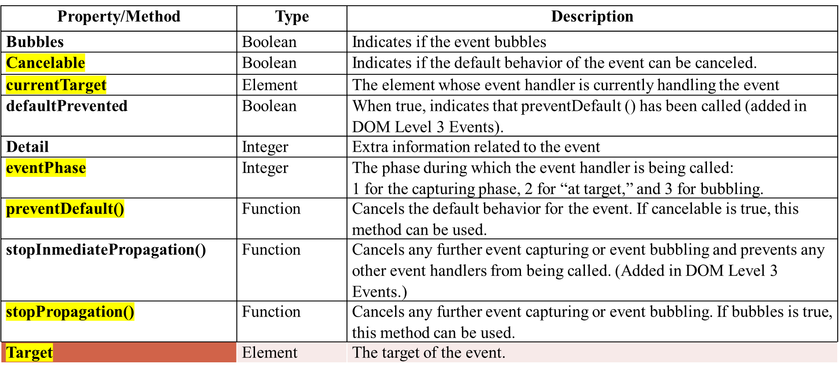
The DOM Event Object
Information Technology Supporting and Maintenance

Slide 26
Example
<!DOCTYPE html>
<html>
<head><title> DOM Level 0 Event Object Example </title></head>
<body>
<input type="button" value="Click Me" id="myBtn">
<script type="text/javascript">
var btn=document.getElementById("myBtn");
btn.onclick=function(event){
alert(event.type);}
</script></body></html>
Information Technology Supporting and Maintenance

Slide 27
Example
<!DOCTYPE html>
<html>
<head><title> DOM Level 2 Event Object Example </title></head>
<body>
<input type="button" value="Click Me" id="myBtn">
<script type="text/javascript">
var btn=document.getElementById("myBtn");
var h=function(event){
alert(event.type); };
btn.addEventListener("click",h)
</script></body></html>
Information Technology Supporting and Maintenance

Slide 28
DOM Event Object
<!DOCTYPE html><html>
<head><title> DOM Event Object Example </title></head>
<body><input type="button" value="Click Me" id="myBtn">
<script type="text/javascript">
var btn=document.getElementById("myBtn");
var h=function(event){
switch(event.type){
case "click":alert("Clicked");break;
case "mouseover":event.target.style.backgroundColor="red";break;
case "mouseout":event.target.style.backgroundColor="";break; }};
btn.onclick=h;
btn.onmouseover=h;
btn.onmouseout=h;
</script></body></html>
Information Technology Supporting and Maintenance

Slide 29
The Internet Explorer Event Object
Property/Method | Type | Description
cancelBubble | Boolean | False by default, but can be set to true to cancel event bubbling (same as the DOM stopPropagation() method).
returnValue | Boolean | True by default, but can be set to false to cancel the default behavior of the event (same as the DOM preventDefault() method).
srcElement | Element | The target of the event (same as the DOM target property).
type | String | The type of event that was fired.
Information Technology Supporting and Maintenance

Slide 30
EventUtil Object
EventUitl={getTarget: function(event){
return event.target || event.srcElement;
},
preventDefault: function(event){
if (event.preventDefault){
event.preventDefault(); }
else { event.returnValue = false;
} },
stopPropagation: function(event){
if (event.stopPropagation){
event.stopPropagation(); }
else { event.cancelBubble = true; } } };
Save-→EventUtil.js
Information Technology Supporting and Maintenance

Slide 31
Example
<!DOCTYPE html>
<html><head>
<title> IE Event Object Example </title></head>
<body>
<input type="button" value="Click Me" id=“myBtn”>
<script type=“text/javascript”>
var btn=document.getElementById(“myBtn”);
btn.attachEvent(“onclick”,function(event){alert(event.type);});
(or)
btn.onclick=function(){ var event=window.event;
alert(event.type);};
</script></body></html>
Information Technology Supporting and Maintenance

Slide 32
Target of the event
In DOM
btn.onclick=function(event){
alert(event.target);
};
In IE
btn.onclick=function(){
alert(window.event.srcElement);
};
Information Technology Supporting and Maintenance

Slide 33
Cancel the default behavior
In DOM
preventDefault()
- is used to prevent the default action of a particular event.
Eg:
<body>
<a href=http://www.wrox.com “ id=“myLink”>Click Me</a>
<script type=“text/javascript”>
var link=document.getElementById(“myLink”);
link.onclick=function(event){
event.preventDefault();
};
</script></body>
Information Technology Supporting and Maintenance

Slide 34
Cancel the default behavior
In IE
returnValue=false;
Eg:
<body>
<a href=http://www.wrox.com “ id=“myLink”>Click Me</a>
<script type=“text/javascript”>
var link=document.getElementById(“myLink”);
link.onclick=function(){
window.event.returnValue=false;
};
</script></body>
Information Technology Supporting and Maintenance

Slide 35
Cancel any further event
In DOM
stopPropagation()
<body>
<input type="button" value="Click Me" id=“myBtn”>
<script type=“text/javascript”>
var btn=document.getElementById(“myBtn”);
btn.onclick=function(event){
alert(“Clicked”);
event.stopPropagation();}
document.body.onclick=function(event){
alert(“Body clicked”);};
</script></body
Information Technology Supporting and Maintenance

Slide 36
Cancel any further event
In IE
cancelBubble=true;
<body>
<input type="button" value="Click Me" id=“myBtn”>
<script type=“text/javascript”>
var btn=document.getElementById(“myBtn”);
btn.onclick=function(){
alert(“Clicked”);
window.event.cancelBubble=true;};
document.body.onclick=function(event){
alert(“Body clicked”);};
</script></body>
Information Technology Supporting and Maintenance

Slide 37
5. Cross-Browser Event Object
preventDefault()
<head>
<title>Cross-Browser Event Object Example</tilte>
<script type=“text/javscript” src=“EventUtil.js”></script></head>
<body>
<a href=http://www.wrox.com “ id=“myLink”>Click Me</a>
<script type=“text/javascript”>
var link=document.getElementById(“myLink”);
link.onclick=function(event){
event=EventUtil.getEvent(event);
EventUtil.preventDefault(event);
};
</script></body>
Information Technology Supporting and Maintenance

Slide 38
5. Cross-Browser Event Object
stopPropagation()
<head>
<title>Cross-Browser Event Object Example</tilte>
<script type=“text/javscript” src=“EventUtil.js”></script></head>
<body>
<input type="button" value="Click Me" id=“myBtn”>
<script type=“text/javascript”>
var btn=document.getElementById(“myBtn”);
btn.onclick=function(event){ alert(“Clicked”);
event=EventUtil.getEvent(event);
EventUtil.stopPropagation(event);};
document.body.onclick=function(event){alert(“Body clicked”);};
</script></body
Information Technology Supporting and Maintenance

Slide 39
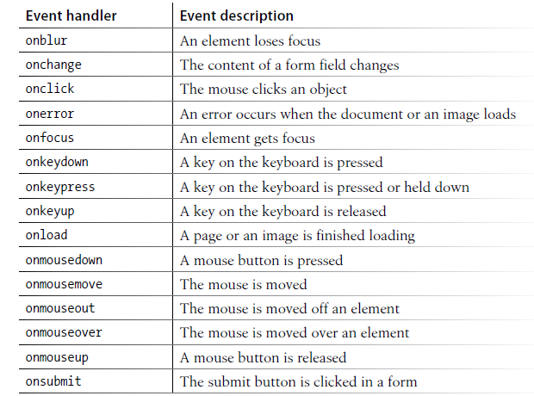
Events Type
Information Technology Supporting and Maintenance

Slide 40
Load Event
The load event is the most often used event in JavaScript
The load event fires when the entire page has been loaded
Eg 1:
<!DOCTYPE html>
<html>
<head>
<title> Load Event Example </title> </head>
<body onload=”alert(‘Loaded!’)”>
</body> </html>
Information Technology Supporting and Maintenance

Slide 41
Load Event
Eg 2:<img src="Penguins.jpg" onload="alert('Image loaded.')"/>
<html><head><title> Load Event Example </title></head>
<body>
<img src = “smile.gif” id= “m1”/>
<script type= “text/javascript”>
var m = document.getElementById(“m1”);
EventUtil.addHandler ( m, “load”, function( ){ alert(“Image Loaded”);});
</script></body></html>
Information Technology Supporting and Maintenance

Slide 42
Load Event
<html><head>
<script type="text/javascript" src="EventUtil.js"></script></head>
<body>
<script type="text/javascript">
EventUtil.addHandler(window,"load",function(){
var image=document.createElement("img");
EventUtil.addHandler(image,"load",function(event){
event=EventUtil.getEvent(event);
alert(EventUtil.getTarget(event).src);});
document.body.appendChild(image);
image.src="Koala.jpg";});
</script></body></html>
Information Technology Supporting and Maintenance

Slide 43
Load Event
<html>
<head> <title> Load Event Example 6</title></head>
<body>
<script type= “text/javascript”>
EventUtil.addHandler(window, “load”, function(){
var s = document.createElement(“script”);
s.type = “text/javascript”;
s.src = “hello.js”;
EventUtil.addHandler(s, “load”, function(event){alert(“Loaded”);});
document.body.appendChild(s);
});</script></body></html>
Information Technology Supporting and Maintenance

Slide 44
Load Event
Eg 7:
<html>
<head> <title> Load Event Example 7</title></head>
<body>
<script type= “text/javascript”>
EventUtil.addHandler(window, “load”, function(){
var link = document.createElement(“link”);
link.type = “text/css”;
link.rel= “stylesheet”;
EventUtil.addHandler(link, “load”, function(event){alert(“css loaded”);});
link.href = “color.css”;
document.getElementsByTagName(“head”)[0].appendChild(link); });
</script></body></html>
Information Technology Supporting and Maintenance

Slide 45
unload Event
The unload event fires when a document has completely unloaded.
The unload event fires when navigating from one page to another
Eg1:
<!DOCTYPE html><html><head>
<title>Unload Event Example 1</title></head>
<body>
<p>Unload event example - navigate to another page or close this tab/window to fire the event.</p>
<script type="text/javascript">
window.onunload=function(event){
alert(“Unload”);};
</script></body></html>
Information Technology Supporting and Maintenance

Slide 46
unload Event
Eg 2:
<!DOCTYPE html>
<html>
<head> <title> Unload Event Example 2</title> </head>
<body onunload=”alert(‘Unloaded!’)”>
</body>
</html>
Information Technology Supporting and Maintenance

Slide 47
resize Event
The resize Event
The resize event fires on window
The resize event fires when the broswer window is resized to a new height or width
Eg: 1
<!DOCTYPE html><html>
<head><title> Resize Event Example 1</title>
</head>
<body>
<p>Resize event example - resize the browser window.</p>
<script type="text/javascript">
window.onresize=function(event){
alert("Resized");
}); </script></body></html>
Information Technology Supporting and Maintenance

Slide 48
Context Menu Event
The oncontextmenu event occurs when the user right-clicks on an element to open the context menu.
<html>
<head>
<script type="text/javascript" src="EventUtil.js"></script>
</head>
<body>
<div id="myDiv">Right click or Ctrl+click me to get a custom context menu.Click anywhere else to get the default context menu.</div>
<ul id="myMenu" style="position:absolute;visibility:hidden;background-color:silver">
<li><a href="http://www.nczonline.net">Nicholas' site</a></li>
<li><a href="http://www.wrox.com">Wrox site</a></li>
<li><a href="http://www.yahoo.com">Yahoo!</a></li>
</ul>ncept of context menus to PC users via a right mouse click
Information Technology Supporting and Maintenance

Slide 49
Context Menu Event
<script type="text/javascript">
EventUtil.addHandler(window,"load",function(event){
var div=document.getElementById("myDiv");
EventUtil.addHandler(div,"contextmenu",function(event){
event=EventUtil.getEvent(event);
EventUtil.preventDefault(event);
var menu=document.getElementById("myMenu");
menu.style.left=event.clientX+"px";
menu.style.top=event.clientY+"px";
menu.style.visibility="visible";});
EventUtil.addHandler(document,"click",function(event){
document.getElementById("myMenu").style.visibility="hidden";});});
</script></body></html>
Information Technology Supporting and Maintenance

Slide 50
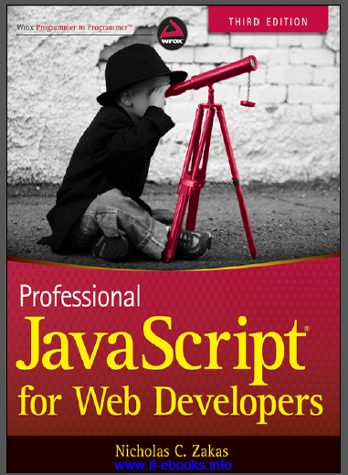
References
“PROFESSIONAL JavaScript for web Developers”
Third Edition
Zichalos C.Zakas
Nicholas, “Professional JavaScript for Web Development”
Colleen van Lent Ph.D, “INTERACTIVITY WITH JAVASCRIPT”
Information Technology Supporting and Maintenance

Slide 51
Thank You
1
Information Technology Supporting and Maintenance

